Slide 1
Solar and Lunar Eclipse Milestone Report
Rachel Raikar
Mentor: Jan Zikeš

Slide 2
Project Outline
Problem Definition
Study the frequency of occurrence of eclipses and determine which eclipses are more common.
Study the correlation between time of year and occurrence of eclipses.
Client Base and Motivation
Astronomers to statistically confirm their theories about the occurrences of eclipses.
Data Overview
Acquired from NASA public dataset domain.
Two separate CSV files with data pertaining to solar and lunar eclipses respectively.

Slide 3
Preliminary Solution Outline
Data exploration and cleansing
Study distributions of months when eclipses occur.
Analyze the data visually and statistically.
Explain findings and practical significance of results.

Slide 4
Data Wrangling
Imported CSV files as PANDAS dataframes and reindexed the rows with the column ‘Catalog number’.
Filtered the data frames to contain only relevant columns:
Solar Eclipses Data Frame
'Calendar Date', 'Eclipse Time', 'Delta T (s)', 'Eclipse Type','Eclipse Magnitude', 'Latitude', 'Longitude', 'Sun Altitude', 'Sun Azimuth', 'Path Width (km)', 'Central Duration'
Lunar Eclipses Data Frame
'Calendar Date', 'Eclipse Time', 'Delta T (s)','Eclipse Type', 'Latitude', 'Longitude', 'Penumbral Eclipse Duration (m)', 'Partial Eclipse Duration (m)','Total Eclipse Duration (m)'

Slide 5
Reorganized data by calendar date in Chronological order
Converted the dates into a list of [year, month, day] for easier analysis of trends.
Note: The years have negative values because the data is during the five millennium period -1999 to +3000 (2000 BCE to 3000 CE).
Missing values appearing as ‘-’ were replaced with NAN values.
No outlier data found.

Slide 6
Data Story
Which type of eclipse is more common?
There seem to be 166 more lunar eclipses than solar eclipses over a 5000 year period
How many solar/lunar eclipses per year on average?
Solar: ~2.3796/yr
Lunar: ~2.4128/yr
Approximately equal - the difference of 166 is only due to the large size of the data.

Slide 7
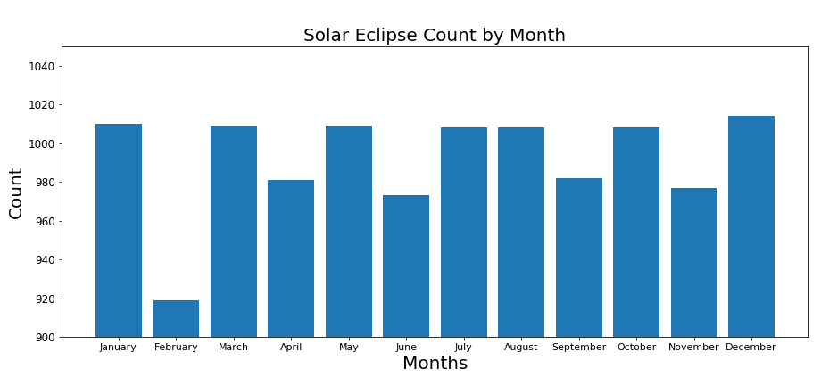
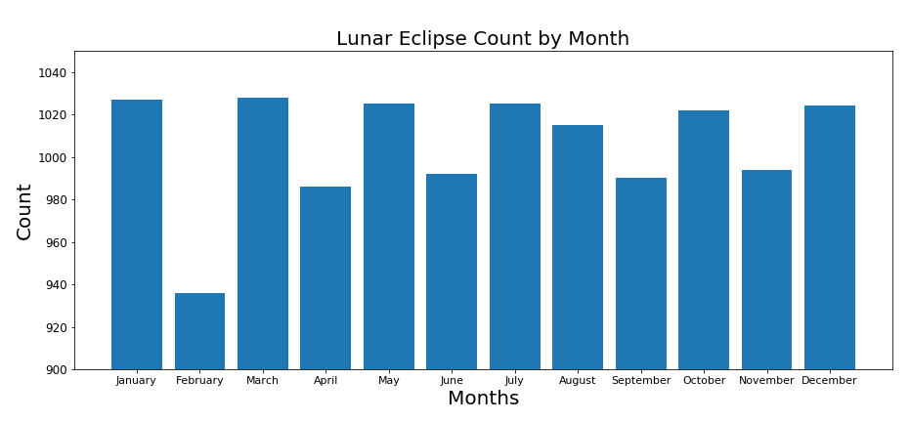
Is there a trend in eclipses vs. month?
Solar and lunar eclipses seem to have relatively the same trend with every month
The slight variation in frequency is due to lengths of the months

Slide 8
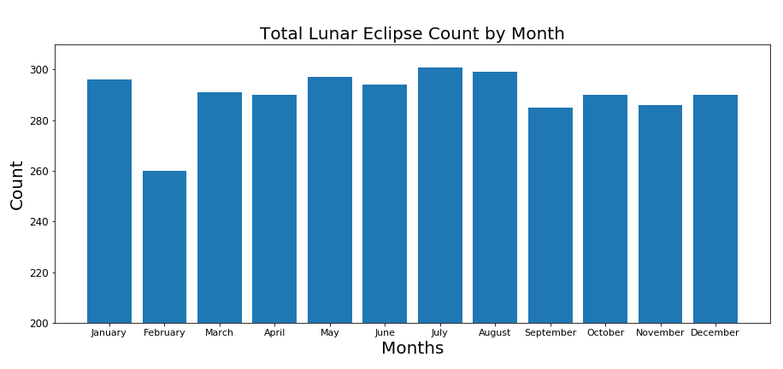
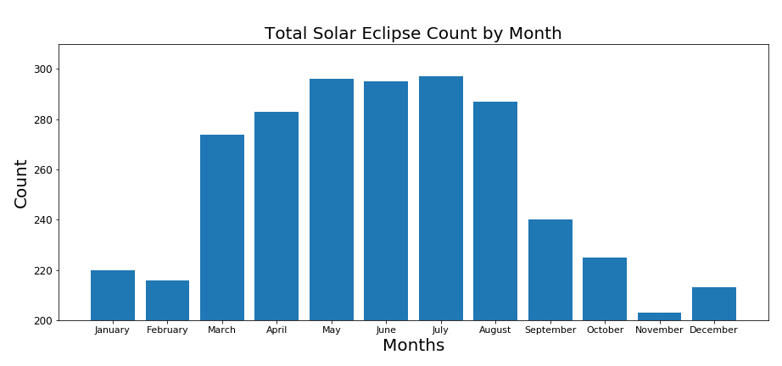
Trends in Total Eclipses
Total solar eclipses seem to veer off this trend greatly. They seem to be more common during the second half of the year during the seasons Fall and Winter (September - January).

Slide 9
Statistical Analysis
Group 1: September - February (Fall - Winter according to US seasons)
Group 2: March - August (Spring - Summer according to US season)
HYPOTHESIS TEST
To test the hypothesis that total eclipse is not directly correlated to the months in the year
𝐻𝑜 : The probability of total eclipse occurring is the same for Group 1 and Group 2. (𝑝1=𝑝2)
𝐻𝑎 : The probability of total eclipse occurring is not the same for Group 1 and Group 2. (𝑝1≠𝑝2)

Slide 10
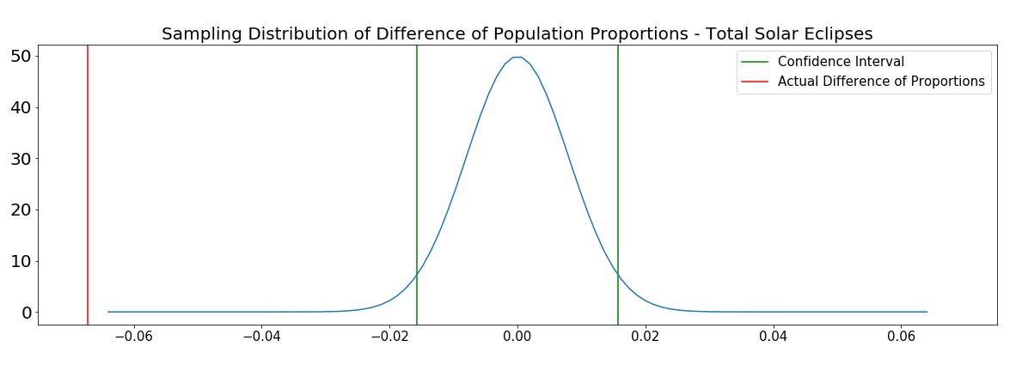
Statistical Analysis of Total Solar Eclipse
Confidence Interval: [-0.01568 0.01568]
Observed Difference: -0.06719

Slide 11
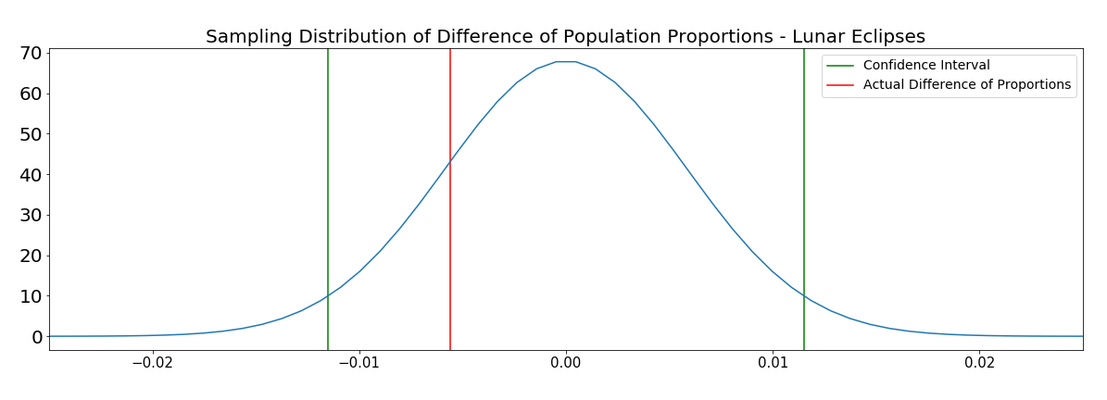
Statistical Analysis of Total Lunar Eclipse
Confidence Interval: [-0.01149 0.01149]
Observed Difference: -0.00560

Slide 12
Machine Learning Analysis
Goal :
Identify supervised learning techniques to predict the date of future total solar and lunar eclipses.
Hypothesis:
It is possible to predict the time and date of the solar and lunar eclipses from the given data leveraging machine learning regression algorithms.

Slide 13
Regression Models Tested
Linear Regression
Model that uses ordinary least squares to minimize the sum of square differences from prediction from true value.
The data was split into ordered train and test sets to keep the dates of the data in order.
Train = 0.75 Test = 0.25
Fitted the training data to linear regression model and predicted the model on testing data.
Ridge Regression
Model similar to linear regression but with a normalization term to reduce overfitting.
The data was split into ordered train and test sets to keep the dates of the data in order.
Train = 0.75 Test = 0.25
Performed GridSearchCV to find the best alpha parameter for the model and cross validation of 5.
Plotted the alphas vs the cross validation of 10 scores for each alpha for visual analysis.
Fitted the training data to ridge regression model and predicted the model on testing data.

Slide 14
Regression Models Tested
Lasso Regression
Model similar to ridge regression but uses absolute values instead of squares to penalize regression coefficients from becoming too large.
The data was split into ordered train and test sets to keep the dates of the data in order.
Train = 0.75 Test = 0.25
Performed GridSearchCV to find the best alpha parameter for the model and cross validation of 5.
Plotted the alphas vs the cross validation of 10 scores for each alpha for visual analysis.
Fitted the training data to lasso regression model and predicted the model on testing data.
Polynomial Linear Regression
Model similar to linear regression but y is modelled using an nth degree polynomial for x instead.
The data was split into ordered train and test sets to keep the dates of the data in order.
Train = 0.75 Test = 0.25
Performed a manual gridsearch to test for the best degree parameter for the Polynomial Features. Best degree = 4
Fitted the training data to polynomial regression model and predicted the model on testing data.

Slide 15
Regression Models Tested
Bayesian Linear Regression
Model similar to linear regression but the model is made with probabilities rather than point estimates.
Performed GridSearchCV to find the best alpha and lambda parameters for the model with cross validation of 5.
Fitted the training data to bayesian regression model and predicted the model on testing data.

Slide 16
Results for the Models
Below are the Root Mean Square Errors (RMSE) computed for total solar and total lunar eclipses for each model.
 | Total Solar (yrs) | Total Lunar (yrs)
Linear Regression | 4.8 | 5.4
Lasso Regression | 4.8 | 5.3
Ridge Regression | 4.9 | 5.3
Polynomial Regression | 4.6 | 4.4
Bayesian Regression | 4.8 | 5.4

Slide 17
Results Analysis
Conclusion:
All RMSE results seem to be around the same range of 4-5 years. This might imply that the data is not suitable for machine learning regression models.
Future Work:
Try different models in the future such as gaussian processes and deep learning models such as neural networks.
Request the data collectors to collect data in a certain way so as to improve the prediction models.
Using standard astrophysics models may prove to be more accurate.

